Slide 1
Happy Little ERS – An Employee Reimbursement System
Brandon Scoggins

Slide 2
Functionality
Login
Register
Employee and Management
Update user information
Create case
Logout

Slide 3
Functionality
Employee
View all owned cases
Sort by resolved or unresolved
Manager
View all owned cases
Sort by resolved or unresolved
Manage all non-owned cases
Sort cases by type and status

Slide 4
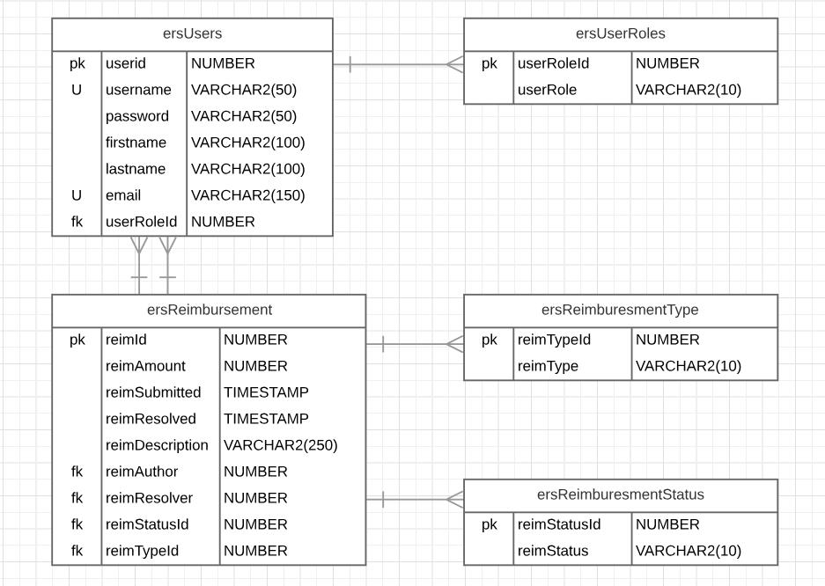
DataBase Diagram

Slide 5
Happy Little ERS

Slide 6
Tech Stack
Database – Oracle SQL Developer
DB Connection – Oracle Java Database Connection
Backend – Java, Tomcat, Maven
Frontend – JavaScript, Jquery, HTML, CSS, AJAX, JSON
Bootstrap Framework

Slide 7
Future Features
Allow feedback from management
Allow users to cancel cases
Let ‘enter’ activate submit buttons

Slide 8
Questions?

